Slide 1

Biologics & Biosimilars
An Introduction from the
Pan-Canadian Oncology Biosimilars Initiative

Slide 2
Pan-Canadian Oncology Biosimilars Initiative
This presentation has been prepared by Cancer Care Ontario and is part of the pan-Canadian Oncology Biosimilars Initiative, funded by the pan-Canadian Pharmaceutical Alliance.
The aim of this presentation is to educate clinicians (oncologists, nurses, pharmacists etc.) on the topic of biologic and biosimilar medications.

Slide 3
Learning Objectives
Define biologic medications (Biologics)
Define biosimilar medications (Biosimilars)
Describe:
How biologics and biosimilars are produced
Why there is inherent variability within and between them
How they are comparable to each other
Explain the regulatory approval process with respect to:
Efficacy, and
Safety (Immunogenicity)
State the regulations around extrapolation in Canada
Describe the implications to your clinical practice in terms of:
Extrapolation, switching, clinical operations, and pharmacovigilance
Notes:
The learning objectives for this presentation are to:
Define biologic medications (Biologics)
Define biosimilar medications (Biosimilars)
Describe:
How biologics and biosimilars are produced
Why there is inherent variability within and between them, and
How they are comparable to each other
Explain the regulatory approval process with respect to:
Efficacy, and
Safety (Immunogenicity)
State the regulations around extrapolation in Canada
Describe the implications to your clinical practice in terms of:
Extrapolation, switching, clinical operations, and pharmacovigilance

Slide 4

What are Biologics?
A biologic is a complex protein molecule created inside a living cell or system.
This living cell (or system) can be a human/mammalian body, a bacterial cell or a cell line from a mammal.
These living cells (or systems) can produce the exact same protein (exact amino acid sequence) and higher level structures.
Biologics help to treat diseases and medical conditions, including:
Image: IGBA. Communication on Biosimilar Medicines. Chap. 1: The Era of Biological Medicines. Available from: http://www.igbamedicines.org/doc/Module1.pdf
Clinic Practice
Extrapolation
Regulatory
Comparability
Variability
Production
Biosimilars
Biologics
Notes:
What are biologics?
A biologic is a complex protein molecule created inside a living cell or system.
This living cell (or system) can be a human/mammalian body, a bacterial cell or a cell line from a mammal. Examples of this are transgenic rabbits, E. Coli bacteria or Chinese Hamster Ovary cell lines.
These living cells (or systems) can produce the exact same protein (in other words, the exact amino acid sequence) and higher level structures.
Biologics help to treat diseases and medical conditions, including: cancers, arthritis, psoriasis, inflammatory digestive disorders, growth disorders and diabetes.
The next slide is a visual representation of the differences between small molecules, simple biologics and very complex biologics
+++++++++++++++++++++++++++++++++++++++++++++++++++
E.Coli cells are used for non-glycosylated biologics (e.g. Insulin, filgrastim) while mammalian cells are needed when glycosylation is required
Types of mammalian cell lines include Chinese Hamster Ovary cells (CHO), Murin hybridomas (mouse myeloma cells), Human Embryonic Kidney cells

Slide 5
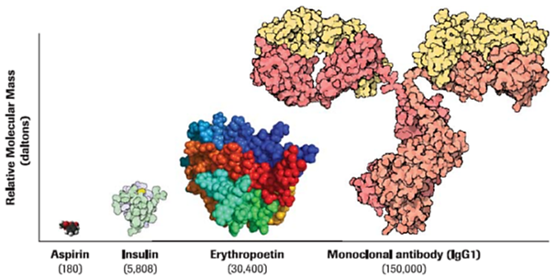
What are Biologics?
How do biologics compare to other medications?
Relative molecular masses are shown in parentheses
Revers L, Furczon E. An introduction to biologics and biosimilars. Part I: Biologics: What are they and where do the come from? CPJ/RPC [Internet]. 2010 May/June; 143(3). Available from: https://www.ncbi.nlm.nih.gov/pmc/articles/PMC3822280/
Clinic Practice
Extrapolation
Regulatory
Comparability
Variability
Production
Biosimilars
Biologics
Notes:
Small molecules (e.g. aspirin) are chemically synthesized and have a very small molecular weight
Biologics are more complicated in structure and require a living system for replication
Simple proteins like insulin can be created inside E. Coli cells. Natural insulin has 51 amino acids, and synthetic insulins have 50-53 amino acids
Larger proteins, like erythropoetins, need to be produced by mammalian cells. Erythropoetins have approximately 165 amino acids and 40-50% of their molecular weight is made up of sugars
Complex large molecules, like monoclonal antibodies, are also produced by mammalian cells. They can have more than 1600 amino acids and do have sugar residues as well

Slide 6
What are Biosimilars?
A biosimilar is a biologic medication that is demonstrated to be highly similar to a biologic medication (branded) that is currently marketed (a.k.a. reference biologic).
They can be sold once the patent of the innovator company (manufacturer of the reference biologic) has expired. [1]
Biosimilars are not necessarily identical to its reference biologic, but based on Health Canada’s guidelines and approval standards for the pharmacokinetics, pharmacodynamics, safety and clinical efficacy of biologics, the two are highly similar. [1-3]
There are no clinically meaningful differences in safety and efficacy between a biosimilar and its reference biologic.
1. Canada. Health Canada. Fact Sheet: Biosimilars. 2017. Available from: https://www.canada.ca/en/health-canada/services/drugs-health-products/biologics-radiopharmaceuticals-genetic-therapies/applications-submissions/guidance-documents/fact-sheet-biosimilars.html
2. ICH Expert Working Group. ICH Harmonised Tripartite Guideline: Comparability of biotechnological/biological products subject to changes in their manufacturing process Q5E. 2004. Available from: https://www.ich.org/fileadmin/Public_Web_Site/ICH_Products/Guidelines/Quality/Q5E/Step4/Q5E_Guideline.pdf
3. Canada. Health Canada. Guidance Document: Information and submission requirements for biosimilar biologic drugs. 2016. Available from: https://www.canada.ca/en/health-canada/services/drugs-health-products/biologics-radiopharmaceuticals-genetic-therapies/applications-submissions/guidance-documents/information-submission-requirements-biosimilar-biologic-drugs.html
Clinic Practice
Extrapolation
Regulatory
Comparability
Variability
Production
Biosimilars
Biologics
Notes:
What are biosimilars?
A biosimilar is a biologic medication that is demonstrated to be highly similar to a biologic medication that is currently marketed (a.k.a. reference biologic).
They can be sold in Canada once the patent of the innovator company has expired.
Biosimilars are not necessarily identical to its reference biologic, but based on Health Canada’s guidelines and approval standards for the pharmacokinetics, pharmacodynamics, safety and clinical efficacy of biologics, the two are highly similar.
A biosimilar approved by Health Canada has no clinically meaningful differences in safety and efficacy with its reference biologic

Slide 7
What are Biosimilars?
Are Biosimilars New?
Biosimilars have been approved internationally since 2005.
At that time, Australia approved a biosimilar for human growth hormone.
Europe has 10+ years of experience with biosimilars.
Over 54 biosimilars approved as of March 2019
Nearly 700 million patient days
US and Canada are catching up with the use of biosimilars.
Health Canada approved the first therapeutic oncology biosimilar in 2018.
Generics and Biosimilars Initiative Online. Biosimilars approved in Europe. 2011 [updated 2018 December 14]. Available from: http://www.gabionline.net/Biosimilars/General/Biosimilars-approved-in-Europe
Clinic Practice
Extrapolation
Regulatory
Comparability
Variability
Production
Biosimilars
Biologics
Notes:
Biosimilars are not new.
Biosimilars have been approved internationally since 2005.
At that time, Australia approved a biosimilar for human growth hormone.
Europe has 10+ years of experience with biosimilars.
Over 54 biosimilars approved as of March 2019
Nearly 700 million patient days
US and Canada are catching up with the use of biosimilars.
Health Canada approved the first therapeutic oncology biosimilar in 2018.
+++++++++++++++++++++++++++++++++++++++++++++++++++++++++++++
Canada has been using supportive biosimilars since Dec 2015 – filgrastim (Grastofil)

Slide 8
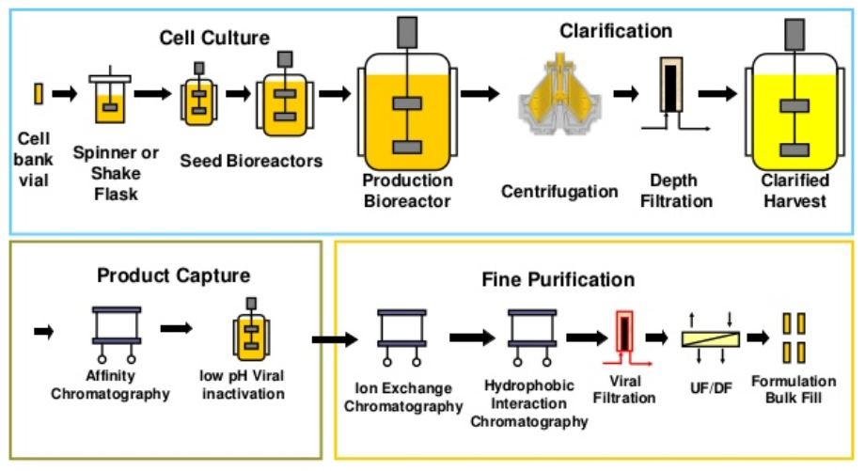
How are Biologics and Biosimilars Produced?
Manufacturing Process – A Simple Overview
Master cell lines are cultured from cell banks in bioreactors to increase number of cells.
The cells are then induced to produce the biologic product.
The resulting product is purified and formulated for clinical use.
Worcester Polytechnic Institute. An overview of biologics manufacturing processes and things to consider from development to commercial sale [Webinar]. 2016. Available from: https://www.slideshare.net/WPICPE/an-overview-of-biologics-manufacturing-processes-and-things-to-consider-from-development-to-commercial-scale
Clinic Practice
Extrapolation
Regulatory
Comparability
Variability
Production
Biosimilars
Biologics
Notes:
How are Biologics and Biosimilars Produced?
A simplified description of the process is:
Master cell lines are cultured from cell banks in bioreactors to expand the number of cells
These cells are then induced to produce the biologics
The resulting product is then purified and formulated for clinical use

Slide 9
Biologics and Biosimilars – Inherent Variability
Why does their production lead to inherent variability?
For all biologics (biosimilars included), the exact same molecule cannot be produced every time, specifically when using mammalian cells; there is some natural variability between the molecules produced.
However, variability must remain within a regulated threshold from batch to batch.
When changes are made to a manufacturing process, the biologic products made after the change in process are not identical to the products made before the change, however they are highly similar.
Thus, manufacturers must demonstrate to regulators that these changes do not have an adverse impact on the safety or efficacy of their product.
ICH Expert Working Group. ICH Harmonised Tripartite Guideline: Comparability of biotechnological/biological products subject to changes in their manufacturing process Q5E. 2004. Available from: https://www.ich.org/fileadmin/Public_Web_Site/ICH_Products/Guidelines/Quality/Q5E/Step4/Q5E_Guideline.pdf
Clinic Practice
Extrapolation
Regulatory
Comparability
Variability
Production
Biosimilars
Biologics
Notes:
Biologics and Biosimilars have inherent variability.
Why does their production lead to this?
For all biologics (biosimilars included), the exact same molecule cannot be produced every time, specifically when using mammalian cells; there is some natural variability between the molecules produced. This is because of the post-translational modifications, primarily the glycosylation of the proteins.
However, variability must remain within a regulated threshold from batch to batch. The approval of the process of making a biologic gives boundaries as to how much variability is allowed to exist in a biologic in order for it to be considered comparable or highly similar to the approved biologic medication.
When changes are made to a manufacturing process, the biologic products made after the change in process are not identical to the products made before the change, however they are highly similar.
Thus, manufacturers must demonstrate to regulators that these changes do not have an adverse impact on the safety or efficacy of their product.

Slide 10
Biologics and Biosimilars – Inherent Variability
How is variability demonstrated?
Variability is demonstrated by characterizing the key attributes of the biologic/biosimilar.
Number of key attributes vary from biologic to biologic and there are many.
The key attributes for biologics (including biosimilars) include:
Amino acid sequence of the protein (must be identical)
Primary structure
Glycosylation patterns
Other modifications
For monoclonal antibodies specifically, there are two key attributes:
Binding to their target (antigen)
Ability to activate the immune system (if that is part of their mechanism of action)
Ishii-Watabe A, Kuwabara T. Biosimilarity assessment of biosimilar therapeutic monoclonal antibodies. Drug Metab Pharmacokinet [Internet]. 2019; 34(1): 64.70. Available from: https://www.sciencedirect.com/science/article/pii/S1347436718304580?via%3Dihub
Clinic Practice
Extrapolation
Regulatory
Comparability
Variability
Production
Biosimilars
Biologics
Notes:
How is this variability demonstrated?
Variability is demonstrated by characterizing the key attributes of the biologic/biosimilar.
The number of key attributes varies from biologic to biologic and there are many.
The key attributes for biologics (including biosimilars) include:
Amino acid sequence of the protein (which must be identical)
Primary structure
Glycosylation patterns
Other modifications
For monoclonal antibodies specifically, there are two key attributes:
Binding to their target (antigen)
Ability to activate the immune system (if that is part of their mechanism of action). Examples are antigen-dependent cellular cytotoxicity and complement dependent cytotoxicity

Slide 11
Biologics and Biosimilars
Important Attributes of Oncology Biologics which have Biosimilars
mAb | Antigen | Directly Affect Signal Transduction | ADCC
Bevacizumab | VEGF-A | No – sequestering signaling ligand (VEGF-A) | No
Trastuzumab | HER/2-Receptor ligand binding site | Yes – apoptosis pathway | Yes
Rituximab | CD20 | No | Yes
mAb – Monoclonal Antibodies
ADCC – Antibody Dependent Cellular Cytotoxicity
Signal transduction – External ligand binding induces internal cell signalling
Clinic Practice
Extrapolation
Regulatory
Comparability
Variability
Production
Biosimilars
Biologics
Notes:
This is a table that summarizes the key attributes of some important oncology biologics that face biosimilar competition in the near future. They are important to understand their relationships to the natural variability of biologics and biosimilars.
This is important as each biologic has very different characteristics that require clarification.
The antigens are obviously all different but impact the mechanism of action of the medication. Bevacizumab really only targets VEGF, not any target on a cancer cell. Trastuzumab will bind to the HER/2 transmembrane tyrosine kinase receptor. Rituximab binds to the CD20 antigen on all mature B-cells or other CD20 positive hematologic cells.
Signal transduction is one mechanism of action that is important in cancer cells. Bevacizumab does not directly impact signal transduction as it sequesters the ligand that stimulates the VEGF-receptor. This does not target cancer cells, only the vasculature that will supply the entire tumour with oxygen and nutrients. Trastuzumab has a direct effect on the anti-apoptotic HER/2 pathway – by blocking the ligand binding site it allows the cell that has the HER/2 receptor to undergo apoptosis if is signaled to do so by another pathway. This may include chemotherapy signaling cell death that is protected by the HER/2 pathway. Rituximab binds to the CD20 antigen on the cell surface – CD20 is thought to be a calcium channel but rituximab does not affect this function.
ADCC is an important mechanism of action for trastuzumab and rituximab. Both of these medications rely on ADCC in order to enhance their effects on the cells that hosts their target.

Slide 12
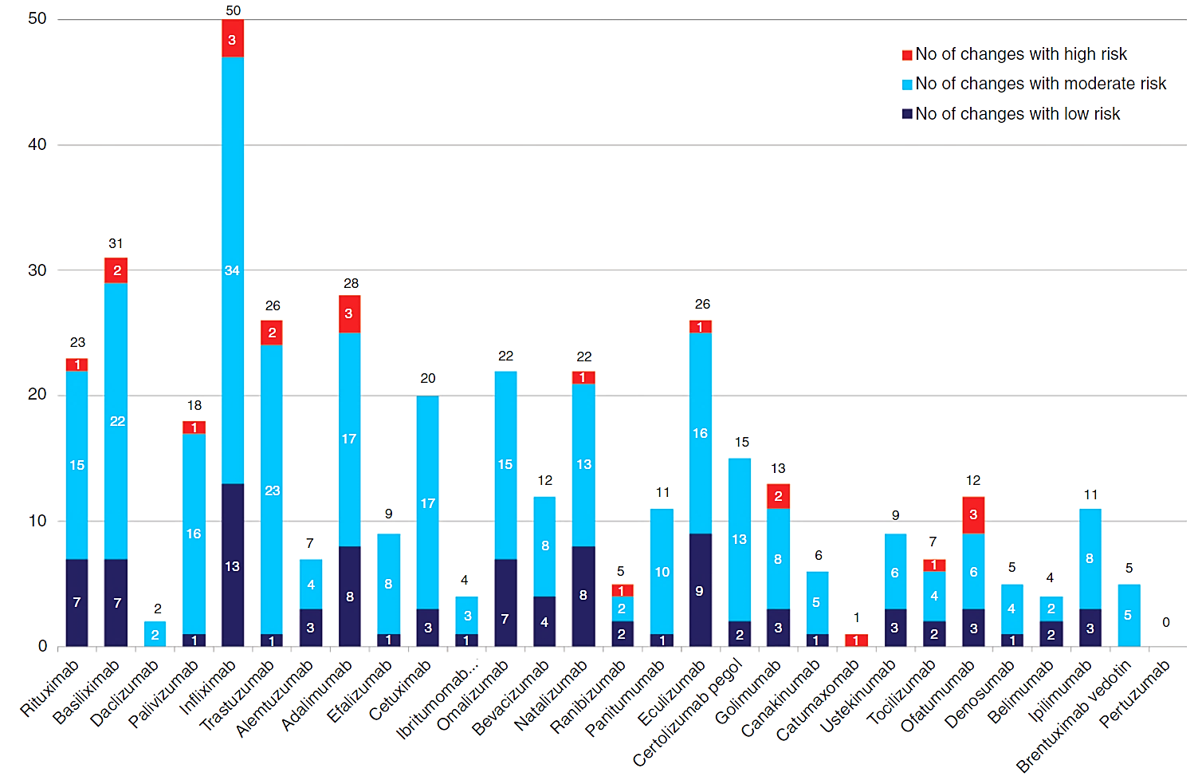
Biologics and Biosimilars – Inherent Variability
Significance of Changes to the Production Process after Licensing
Vezer B, Buzas Z, Sebezta M, Zrubka Z. Authorized manufacturing changes for therapeutic monoclonal antibodies (mAbs) in European Public Assessment Report (EPAR) documents. Curr Med Res Opin [Internet]. 2016 May;32(5): 829-34. Available from: https://www.ncbi.nlm.nih.gov/pubmed/26808864
Clinic Practice
Extrapolation
Regulatory
Comparability
Variability
Production
Biosimilars
Biologics
Notes:
What is the Significance of Changes to the Production Process after Licensing of a biologic?
When biologics were first developed, it was assumed that the approved process for manufacturing the biologic would not change. However as scientific data grew and matured, companies have made changes for non-medical reasons.
Regulators, like Health Canada, take a risk-based approach when evaluating the potential impact of the change
Low risk changes may require very little evidence to demonstrate comparability
High risk changes may require extensive evidence for comparability and may even require a clinical trial
Relevant to oncology biologics that are used in Canada, the biologics produced in the EU have had several changes in their production process. For example:
Rituximab has had 23 changes, one that was considered high risk
Trastuzumab has had 26 changes, 2 that were considered high risk
Bevacizumab has had 12 changes, none of which were considered high risk
++++++++++++++++++++++++++++++++++++++++++++++++++++++++++++++
From the paper referenced above:
High Risk manufacturing changes
Change in the purification of the active substance.
Change in synthesis or recovery of a non-pharmacopoeial or novel excipient.
Change in the manufacturer of AS (active substance) or of a starting material/reagent/intermediate for AS – the proposed manufacturer uses a substantially different route of synthesis or manufacturing conditions.
Change in batch size (including batch size ranges) of AS or intermediate – the change requires assessment of the comparability of a biological/immunological AS.
Change to in-process tests or limits applied during the manufacture of the AS – widening of the approved in-process test limits, which may have a significant effect on the overall quality of the AS.
Moderate-risk manufacturing changes
Change(s) to the manufacturing process for the active substance.
Changes in the manufacturing process of the AS – the change refers to a [-] substance in the manufacture of a biological/immunological medicinal product and is not related to a protocol.
Change in the manufacturer of AS or of a starting material/reagent/intermediate for AS.
Change to in-process tests or limits applied during the manufacture of the AS.
Change in the manufacturer of AS or of a starting material/reagent/intermediate for AS – the change relates to a biological AS or a starting material [-] used in the manufacture of a biological/immunological product.
Low-risk manufacturing
Change in the manufacturing process of the finished product (FP).
Replacement or addition of a manufacturing site for the FP – site where any manufacturing operation(s) take place, except batch release, batch control, and secondary packaging, for biological/immunological medicinal products.
Change to in-process tests or limits applied during the manufacture of the finished product.
Change in immediate packaging of the finished product – qualitative and quantitative composition.
Changes to the manufacturing facility of the finished product.

Slide 13
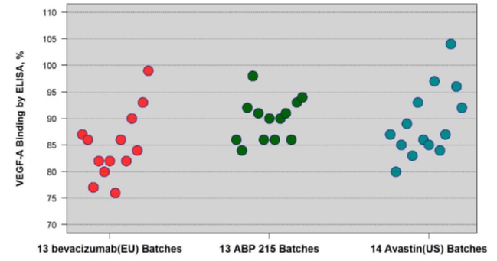
Biologics and Biosimilars – Inherent Variability
Antigen Binding Variability of bevacizumab
Scatter plots of VEGF-A binding by ELISA for US-licensed Avastin, ABP215, and EU-approved bevacizumab
FDA US Food and Drug Administration. Oncologic Drugs Advisory Committee. ABP215, a proposed biosimilar to Avastin (bevacizumab): ODAC briefing document. 2017. Available from: https://www.fda.gov/downloads/AdvisoryCommittees/CommitteesMeetingMaterials/Drugs/OncologicDrugsAdvisoryCommittee/UCM566365.pdf
ELISA – Enzyme-linked Immunosorbent Assay
Clinic Practice
Extrapolation
Regulatory
Comparability
Variability
Production
Biosimilars
Biologics
Notes:
The changes in process and the natural variability lead to variable quality characteristics.
Here we see the effects on the antigen binding ability of EU, US and biosimilar bevacizumab
This scatter plot demonstrates the characterization of the VEGF-binding of the three biologics, one of which is referencing the other two as a biosimilar.
Since this is its primary MOA the activity of binding VEGF must be highly conserved.
The range of activity of the EU batches was from ~75% to 100%
The range of activity of the US batches was from ~80% to 105%
The proposed biosimilar MVASI had activity that ranged from ~85-100%. This was part of the non-clinical data that allowed the FDA to declare MVASI comparable to Avastin and licensed as a biosimilar

Slide 14
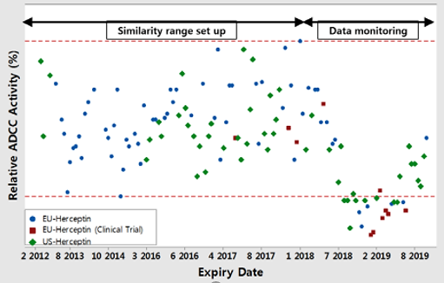
Biologics and Biosimilars – Inherent Variability
ADCC Activity of EU Herceptin, EU Herceptin (Clinical), US Herceptin
European Medicines Agency. Assessment Report Ontruzant; International non-proprietary name: trastuzumab. 2017. Available from: https://www.ema.europa.eu/en/documents/assessment-report/ontruzant-epar-public-assessment-report_en.pdf
ADCC = Antibody dependent cellular cytotoxicity
Clinic Practice
Extrapolation
Regulatory
Comparability
Variability
Production
Biosimilars
Biologics
Notes:
This scatter plot demonstrates how the ADCC activity is much more variable in the EU and US batches of Herceptin.
The relative ADCC activity ranges from 65-140% - this demonstrates that this key attribute has significant natural variability
As per the Health Canada Summary Basis of decision document, the biosimilar must show that its range of variability is highly similar to the innovator biologic

Slide 15
Biologic and Biosimilar Comparability
What is comparability?
“Comparability does not necessarily mean that the quality attributes of the pre-change and post-change [from manufacturing] are identical, but that they are highly similar and that the existing knowledge is sufficiently predictive to ensure that any differences in quality attributes have no adverse impact upon safety or efficacy of the drug product.” [1]
Oncology biologic produced in EU site is comparable to that produced in US site
“The manufacturing process for trastuzumab Active Pharmaceutical Ingredient (API) was successfully transferred from… USA [site] to… Germany site… As a result of the process validation, the USA and the Germany process[sic] were found to be comparable. In particular, the analytical comparability of the USA and Germany API could be demonstrated.” [2]
ICH Expert Working Group. ICH Harmonised Tripartite Guideline: Comparability of biotechnological/biological products subject to changes in their manufacturing process Q5E. 2004. Available from: https://www.ich.org/fileadmin/Public_Web_Site/ICH_Products/Guidelines/Quality/Q5E/Step4/Q5E_Guideline.pdf
Kuhne W. Site transfer and process validation in case of Herceptin API. Dev Biol (Basel) [Internet]. 2003;113:47-50. Available from: https://www.ncbi.nlm.nih.gov/pubmed/14620851.
Clinic Practice
Extrapolation
Regulatory
Comparability
Variability
Production
Biosimilars
Biologics
Notes:
Now that we have examined the natural variability of biologics and biosimilars, it explains why biologics and biosimilars can only be comparable, not identical. The general principle about comparability is that it does not necessarily mean that the quality attributes of the pre-change and post-change [from manufacturing] are identical, but that they are highly similar and that the existing knowledge is sufficiently predictive to ensure that any differences in quality attributes have no adverse impact upon safety or efficacy of the drug product.
An example of this from the literature is when the manufacturing process for trastuzumab Active Pharmaceutical Ingredient (API) was successfully transferred from… USA [site] to… Germany site… As a result of the process validation, the USA and the Germany processes were found to be comparable. In particular, the analytical comparability of the USA and Germany API could be demonstrated
This demonstrates that a biologic product, that originates from within the originator company, when produced at a different manufacturing facility, is only deemed to be comparable to the product from the other manufacturing sites that it is also manufactured at.

Slide 16
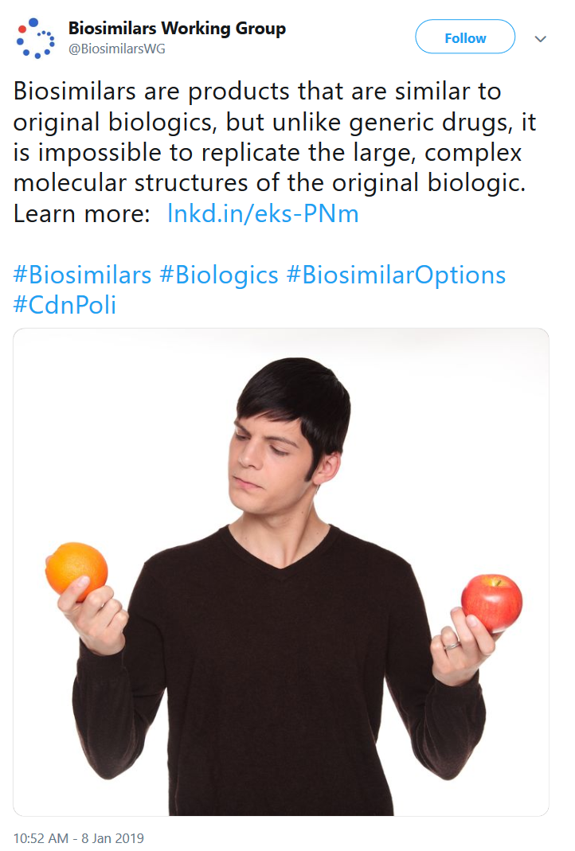
Biologic and Biosimilar Comparability
Is comparing Biosimilars to Biologics like comparing Apples to Oranges?
Organizations critical of biosimilars have alluded to this comparison.
As an analogy, it is more like comparing Red Delicious Apples from Orchard A to Red Delicious Apples from Orchard B.
Despite being “manufactured” at two different sites by two different processes, you would not be able to tell the difference between the apples without being told where they came from!
There is inherent variability in the manufacturing of Red Delicious Apples which results in a difference in size, weight etc.
Biosimilars Working Group. Biosimilars are products that are similar to original biologics, but unlike generic drugs, it is impossible to replicate the large, complex molecular structures of the original biologic. Learn more: Inkd.in/eks-PNm [Tweet]. 2019 Jan 8. Available from: https://twitter.com/BiosimilarsWG/status/1082666309773455360
Clinic Practice
Extrapolation
Regulatory
Comparability
Variability
Production
Biosimilars
Biologics
Notes:
As a conclusion to the discussion about biologics, biosimilars and what “highly similar” and “comparable” actually mean, it is worthwhile pointing out how organizations that have been critical of biosimilars use the terms incorrectly and deceptively. The Biosimilars Working Group (https://biosimilaroptions.ca/) produced the tweet that is shown in this slide. They claim that biologics and biosimilars are as different as apples and oranges. This claim is misleading and they use the term “similar” in an inappropriate way. This misinformation is primarily targeted at patients to reduce their confidence in biosimilars.
The concept of apples and oranges is an inappropriate comparison. Apples and oranges are very different, not even remotely similar.
As an analogy, it is more like comparing Red Delicious Apples from Orchard A to Red Delicious Apples from Orchard B.
Despite being “manufactured” at two different sites by two different processes, you would not be able to tell the difference between the apples without being told where they came from!
There is inherent variability in the manufacturing of Red Delicious Apples which results in a difference in size, weight etcetera.
It is important to understand the appropriate and inappropriate uses of the terms surrounding biosimilars, especially when they are used to create confusion and reduce confidence in biosimilars.

Slide 17
Regulatory Approval Process
What information do regulators require for approval?
Reference Biologic
Biosimilar
Determining the clinical effects of the biologic
Determining the comparability/similarity to the biologic
Clinical
PK/PD
Non-clinical
PK/PD
Analytical
Non-clinical
Clinical
Pharmacokinetics/
Pharmacodynamics
Analytical
Adapted from: McCamish M, Woollett G. Worldwide experience with biosimilar development. Mabs [Internet] 2011 Mar-Apr;3(2): 209-17.
and McCamish M, Woollett G. The state of the art in the development of biosimilars. Clin Pharmacol Ther [Internet]. 2012;91(3): 405-17.
Clinic Practice
Extrapolation
Regulatory
Comparability
Variability
Production
Biosimilars
Biologics
Notes:
Now looking at the regulatory approval process – what information is needed by regulators for approval?
Both reference biologic and biosimilar need clinical data, pharmacokinetic and pharmacodynamic data, non-clinical as well as analytic data.
These pyramids represent the evidence or data that is generated in order for a product to become approved. While they are visually the same size in order to be readable, the amount of data that a manufacturer of a biosimilar submits for approval is overall less than what is needed for the reference biologic. This is primarily due to the reduction in clinical data. This reduction in clinical data is why biosimilars can be less expensive – there are fewer resources needed for approval.
Clinical data includes the various clinical trials that are needed to demonstrate activity. For originator products this includes Phase I, II and III trials in all of the indications that they are seeking to determine the effectiveness in. For biosimilars, there is no requirement for any Phase II trials as the proposed biosimilar only needs a Phase I trial for pharmacokinetic and pharmacodynamic data, followed by a Phase III trial in a sensitive population.
Non-clinical data includes the pharmacology of the molecule, such as in-vitro activity. This varies from biologic to biologic. In-vitro activity can include the binding to the antigen/target, the effects on the target, the recruitment of the immune system as well as other product specific activity that the manufacturer and regulator deem appropriate to demonstrate comparability. Pharmacokinetic and pharmacodynamic (PK/PD) data are non-clinical as well but occur in humans or suitable surrogates (for example mice, rats).
Analytical data refers to the analysis or characterization of the biologic and biosimilar. Prior to any other activity in demonstrating comparability to the reference biologic, the process that creates the proposed biosimilar must demonstrate analytic comparability to its reference.
+++++++++++++++++++++++++++++++++++++++++++++++++++++++++++++++
Cell biologists and bioprocess engineers have boosted cell culture yields from 100 milligrams per liter in the early 1980s (at a cost of $10,000 per gram) to 5 grams per liter today (at $100 per gram) http://biomanufacturing.org/uploads/files/547998065159985597-cho-history.pdf (2015)

Slide 18
Regulatory Approval Process
Regulatory Requirements
No two batches of a biologic are identical to each other.
International guidance exists to keep biologic batches comparable/highly similar to ensure the safety and efficacy of the batches.
Biosimilars must characterize the key quality attributes of its reference biologic and demonstrate comparability.
It is impossible to determine the source of a biologic or biosimilar based on its quality characteristics.
Once approved the biosimilar needs to maintain this comparability to the reference biologic.
Health Canada, the EMA and the FDA all use the same international standards in determining comparability/high similarity.
Clinic Practice
Extrapolation
Regulatory
Comparability
Variability
Production
Biosimilars
Biologics
Notes:
Based on the previous slide we know that no two batches of a biologic are identical to each other, and there is International guidance to keep biologic batches comparable/highly similar to ensure the safety and efficacy of the batches.
The biosimilar manufacturers must characterize the key quality attributes of its reference biologic and demonstrate comparability.
It is impossible to determine the source of a biologic or biosimilar based on its quality characteristics.
Once approved the biosimilar needs to maintain this comparability to the reference biologic.
Health Canada, the EMA and the FDA all use the same international standards in determining comparability/high similarity.

Slide 19
Regulatory Approval Process
Regulatory Requirements
Clinical trials are almost always needed for approval of indications.
E.g. A clinical trial was not conducted for bevacizumab in metastatic colorectal cancer as data from NSCLC trials was extrapolated and used for its approval.
The type of clinical trial depends on the type of biologic.
Indications with highly sensitive endpoints may require less evidence needed for approval.
E.g. The first biosimilar filgrastim brands in the EU required Phase III equivalence trials for approval. More recent approvals only require non-comparative safety studies.
This is due to a highly sensitive endpoint, duration of severe neutropenia (DSN), that could be measured.
NSCLC - Non-Small Cell Lung Cancer
Clinic Practice
Extrapolation
Regulatory
Comparability
Variability
Production
Biosimilars
Biologics
Notes:
As to the clinical regulatory requirements, clinical trials are almost always needed for approval of indications.
For example, a clinical trial was not conducted for bevacizumab in metastatic colorectal cancer as data from NSCLC trials was extrapolated and used for its approval.
Now the type of clinical trial depends on the type of biologic.
Indications with highly sensitive endpoints may require less evidence for approval.
For example the first biosimilar filgrastim brands in the EU required Phase III equivalence trials for approval. More recent approvals only require non-comparative safety studies.
This is due to a highly sensitive endpoint, duration of severe neutropenia (DSN), that could be measured.
The following slide summarizes the trials used in approving biosimilar filgrastims

Slide 20
Regulatory Approval Process
Clinical Summary of Phase III filgrastim studies
 | Accofil▲ Grastofil▲, ■ | Neupogen | Nivestim▲, ● | Ratiograstim▲, Tevagrastim▲ | Zarzio▲, ●
Hypothesis | Safety (Non-comparative) |  | Equivalence | Equivalence | Safety (Non-comparative)
Population | Breast Cancer (n=120) | Comparator | Breast Cancer (n=279) | Breast Cancer (n=280) | Breast Cancer (n=170)
1° Endpoint – DSN (days) | 1.4⁴ | 1.3¹ | 1.1² | 1.6¹ | 1.1² | 1.8³
▲ - Biosimilar approved in the EU ■ - Biosimilar approved in Canada ● - Biosimilar approved in USA
DSN – Duration of Severe Neutropenia
European Medicines Agency. CHMP assessment report Nivestim; International non-proprietary name: filgrastim. 2010. Available from: https://www.ema.europa.eu/documents/assessment-report/nivestim-epar-public-assessment-report_en.pdf
European Medicines Agency. Assessment report for Ratiograstim; International non-proprietary name: filgrastim. 2008. Available from: https://www.ema.europa.eu/documents/assessment-report/ratiograstim-epar-public-assessment-report_en.pdf
European Medicines Agency. CHMP assessment report for Zarzio; International non-proprietary name: filgrastim. 2008. Available from: https://www.ema.europa.eu/documents/assessment-report/zarzio-epar-public-assessment-report_en.pdf
European Medicines Agency. Assessment report Grastofil; International non-proprietary name: filgrastim. 2013. Available from: https://www.ema.europa.eu/documents/assessment-report/grastofil-epar-public-assessment-report_en.pdf
Clinic Practice
Extrapolation
Regulatory
Comparability
Variability
Production
Biosimilars
Biologics
Notes:
In this summary of the phase III trials, Nivestim and Tevagrastim used randomized equivalence studies, while Grastofil and Zarzio used safety studies compared to historical clinical trials of filgrastim. Notice the similarity in the highly sensitive endpoint, duration of severe neutropenia, with a range of 1.1 to 1.8 days

Slide 21
Regulatory Approval Process
Regulatory Requirements
Therapeutic oncology biosimilars (e.g. rituximab, trastuzumab, bevacizumab) need more robust clinical data for approval due to a lack of sensitive endpoints.
Clinical trials must be conducted in a suitable indication that has a:
Highly sensitive population – e.g. active disease, medication has a large effect on the disease, patient population is immunocompetent (not suppressed).
Homogeneous population – single disease, with balanced patient characteristics
Equivalence trials are preferred by regulators but non-inferiority trials may be permitted with an appropriate rationale.
Canada. Health Canada. Guidance Document: Information and submission requirements for biosimilar biologic drugs. 2016. Available from: https://www.canada.ca/en/health-canada/services/drugs-health-products/biologics-radiopharmaceuticals-genetic-therapies/applications-submissions/guidance-documents/information-submission-requirements-biosimilar-biologic-drugs.html
Clinic Practice
Extrapolation
Regulatory
Comparability
Variability
Production
Biosimilars
Biologics
Notes:
When we examine the regulatory requirements for therapeutic oncology biosimilars we see that they need more robust clinical data for approval due to a lack of sensitive endpoints.
Clinical trials must be conducted in a suitable indication that has a:
Highly sensitive population – for example, active disease, the medication has a large effect on the disease, and the patient population is immunocompetent (not suppressed).
It must be a homogeneous population – single disease, with balanced patient characteristics
Equivalence trials are preferred by regulators but non-inferiority trials may be permitted with an appropriate rationale. Non-inferiority trials have been used for oncology biologics in conjunction with equivalence trials in non-oncology indications.
Clinical trial design is detailed in the next slide, followed by three slides that are summaries of the top-line clinical results of biosimilars and their reference products. They are not a comprehensive review of the published data (and some data is not yet published). It does however summarize some of the key talking points that many clinicians are either uncertain of or are interested in. These include:
Type or hypothesis of clinical trial (Equivalence vs Non-Inferior)
Which population the trial studied
The size of the clinical trial (some clinicians perceive that the trials are too small as they are comparing the trials to the superiority trials that they are accustomed to reviewing)
The primary and secondary endpoints of the trials – what they are and what the results are from the trial

Slide 22
Regulatory Approval Process
Equivalence vs. Non-inferiority
Inferiority | Non-inferior |  | Superiority
 | Equivalence
-δ
0
+δ
Experimental Treatment – Standard Treatment
δ = pre-specified margin of equivalence / non-inferiority
*Double headed arrows within represent theoretical confidence intervals from a clinical trial.
Clinic Practice
Extrapolation
Regulatory
Comparability
Variability
Production
Biosimilars
Biologics
Notes:
Clinicians are typically exposed to superiority trials. Biosimilars use equivalence and non-inferiority trials. The delta that is used for a trial is agreed by the sponsor and the regulator. For non-inferiority trials, the confidence interval is greater than the non-inferiority margin but does not cross “0”; meeting this criteria allows for a claim non-inferiority of the new treatment
In equivalence trials, the confidence interval is greater than the non-inferiority margin and less than the non-superiority margin; meeting this criteria allows for a claim equivalence of new treatment.
The next three slides summarize the key characteristics of biosimilar clinical trials.

Slide 23
Regulatory Approval Process
Clinical Summary of Phase III rituximab Studies
 | Blitzima▲/Ritemvia▲ Rituzena▲/Truxima▲, ●, ■ | Rituxan/MabThera | Rixathon▲/Riximyo▲ | Rituxan SC
Hypothesis | Non-inferiority |  | Equivalence | Non-inferiority
Population | AFL (n=121) | Comparator | AFL (n=624) | AFL (n=127)
1° Endpoint – ORR | 95.7%² | 87.5%¹ | 90.0%² | 87.1%¹ | 1° Pharmacokinetics
2° Endpoint – ORR |  | 84.4%³ |  | 90.5%³
▲ - Biosimilar approved in the EU ■ - Biosimilar approved in Canada ● - Biosimilar approved in USA
AFL – Advanced Follicular Lymphoma ORR – Overall Response Rate
European Medicines Agency. Assessment report Rixathon; International non-proprietary name: rituximab. 2017. Available from: https://www.ema.europa.eu/documents/assessment-report/Rixathon-epar-public-assessment-report_en.pdf
European Medicines Agency. Assessment report Truxima; International non-proprietary name: rituximab. 2017. Available from: https://www.ema.europa.eu/documents/assessment-report/Truxima-epar-public-assessment-report_en.pdf
European Medicines Agency. Assessment report Mabthera; International non-proprietary name: rituximab. 2014. Available from: https://www.ema.europa.eu/documents/variation-report/mabthera-h-c-165-x-83-epar-assessment-report-extension_en.pdf
Clinic Practice
Extrapolation
Regulatory
Comparability
Variability
Production
Biosimilars
Biologics
Notes:
In the rituximab clinical trials, Truxima demonstrated non-inferiority in a clinical trial with 121 lymphoma patients. Rixathon demonstrated equivalence in a trial with 624 lymphoma patients.
Despite several brand names, there are only two approved rituximab molecules.

Slide 24
Regulatory Approval Process
Clinical Summary of Phase III trastuzumab Studies
 | Ogivri▲, ● | Trazimera▲, ● | Herceptin | Herceptin SC | Kanjinti▲ | Herzuma▲, ● | Ontruzant▲, ●
Hypothesis | Equivalence | Equivalence³ Non-inferior⁴ |  | Non-inferior | Equivalence | Equivalence | Equivalence
Population | MBC (n=500) | MBC³ (n=707) EBC⁴ (n=226) | Comparator | EBC or LABC (n=596) | EBC or LABC (n=725) | EBC or LABC (n=549) | EBC or LABC (n=800)
1° Endpoint – pCR |  | 47.0%⁴ | 50.4%¹|40.5%² 40.7%^{5,6} |50.0%⁴ 42.0%⁸ | 45.4%^{5,6} | 48.0%² | 46.8%¹ | 51.7%⁸
1° Endpoint – ORR | 69.6%⁷ Ratio 1.09 vs reference⁶ | 62.5%³ Ratio 0.940 vs reference³ | 66.5%³ 64.0%⁷
2° Endpoint – ORR |  |  | 84.0%¹ |91.2%⁸ 88.8%^{5,6} | 87.2%^{5,6} |  | 84.3%¹ | 96.3%⁸
2° Endpoint – pCR (breast) |  |  | 45.0%² |  | 51.1%²
MBC [Metastatic Breast Cancer] EBC [Early Breast Cancer (operable)] LABC [Locally Advanced Breast Cancer] pCR [Pathological Complete Response] ORR – [Overall Response Rate] ▲- Biosimilar approved in the EU ● - Biosimilar approved in USA
1. Stebbing J, Baranau Y, Baryash V, Manikhas A, Moiseyenko V, Dzagnidze G, et al. CT-P6 compared with reference trastuzumab for HER2-positive breast cancer: a randomised, double-blind, active-controlled, phase 3 equivalence trial. Lancet Oncol [Internet]. 2017 Jul;18(7): 917-28. Available from: https://www.ncbi.nlm.nih.gov/pubmed/28592386
2. Efficacy and safety of ABP 980 compared with reference trastuzumab in women with HER2-positive early breast cancer (LILAC study): a randomised, double-blind, phase 3 trial. Lance Oncol [Internet]. 2018 Jul;19(7): 987-98. Available from: https://www.ncbi.nlm.nih.gov/pubmed/29880292
3. Pegram MD, Bondarenko I, Moreira Costa Zorzetto M, Hingmire S, Krivorotko PV, Seok Lee K, et al. PF-05280014 (a trastuzumab biosimilar) plus paclitaxel for HER2-positive metastatic breast cancer: a randomised, double-blind study. Br J Cancer [Internet]. 2019;120: 172-82. Available from: https://www.nature.com/articles/s41416-018-0340-2
4. Lammers PE, Dank M, Masetti R, Abbas R, Hilton F, Coppola J, et al. Neoadjuvant PF-05280014 (a potential trastuzumab biosimilar) versus trastuzumab for operable Her2+ breast cancer. Br J Cancer [Internet]. 2018;119: 266-73. Available from: https://www.nature.com/articles/s41416-018-0147-1
5. Ismael G, Hegg R, Muehlbauer S, Heinzmann D, Lum B, Kim SB, et al. Subcutaneous versus intravenous administration of (neo)adjuvant trastuzumab in patient with HER2-positive, clinical stage I-III breast cancer (HannaH study): a phase 3, open-label, multicentre, randomised trial. Lancet Oncol [Internet]. 2012 Sep;13(9): 869-78. Available from: https://www.ncbi.nlm.nih.gov/pubmed/22884505
6. Jackisch C, Kim SB, Semiglazov V, Melichar B, Pivot X, Hillenbach C, et al. Subcutaneous versus intravenous formulation of trastuzumab for HER2-positive early breat cancer: updated results from the phase III HannaH study. Ann Oncol [Internet]. 2015 Feb;26(2): 320-5. Available from: https://academic.oup.com/annonc/article/26/2/320/2800595
7. Rugo HS, Barve A, Waller CF, Hernandez-Bronchud M, Herson J, Yuan J, et al. Effect of a proposed trastuzumab biosimilar compared with trastuzumab on overall response rate in patients with ERBB2 (HER2)-positive metastatic breast cancer: a randomized clinical trial. JAMA [Internet]. 2017 Jan;317(1): 37-47. Available from: https://www.ncbi.nlm.nih.gov/pubmed/27918780
8. Pivot X, Bondarenko I, Nowecki Z, Dvorkin M, Trishkina E, Ahn JH, et al. Phase III, randomized, double-blind study comparing the efficacy, safety, and immunogenicity of SB3 (trastuzumab biosimilar) and reference trastuzumab in patients treated with neoadjuvant therapy for human epidermal growth factor receptor 2-positive early breast cancer. J Clin Oncol [Internet]. 2018 Apr;36(1): 968-74. Available from: https://www.ncbi.nlm.nih.gov/pubmed/29373094
Clinic Practice
Extrapolation
Regulatory
Comparability
Variability
Production
Biosimilars
Biologics
Notes:
For the trastuzumab phase III clinical trials, biosimilar trastuzumab has been studied in both early and metastatic breast cancer. All of the studies have been equivalence studies, except for one non-inferiority study for Trazimera that was conducted for a non-medical reason (a change in process) that was requested by the FDA. All of the studies are deemed to have met the statistical endpoint of equivalence or non-inferiority.
Note the pathologic complete response rate of 40-50% across all trials in early breast cancer, and the overall response rate in the mid to high 60’s in metastatic breast cancer, all demonstrating comparability
+++++++++++++++++++++++++++++++++++++++++++++++++++++++
In all of the studies, one trastuzumab biosimilar explored switching. The Kanjinti trial initially randomized patients to the reference biologic or the biosimilar and patients were treated until their definitive surgery. After surgery, the patients on the reference biologic were then re-randomized to either remain on the reference product or to switch to the biosimilar. No results have been published at the time of disseminating the current slides, however it has been reported that the switch was safe and efficacious by the manufacturer.

Slide 25
Regulatory Approval Process
Clinical Summary of Phase III bevacizumab Studies
 | Mvasi▲, ■, ● | Zirabev▼ | Avastin
Hypothesis | Equivalence | Equivalence
Population | Advanced NSCLC (n=642) | Advanced NSCLC (n=719) | Comparator
1° Endpoint – ORR | 39.0%¹ Risk Ratio 0.93¹ | 45.3%³ Risk Ratio 1.015³ | 41.7%¹ | 44.6%³
2° Endpoint – PFS | 39.9%² | 30.8% (1yr)³ 9.0 months (median)³ | 39.8%² | 29.3% (1yr)³ 7.7 months (median)³
2° Endpoint – DOR (months) | 5.8² |  | 5.6²
▲- Biosimilar approved in the EU ■ - Biosimilar approved in Canada ● - Biosimilar approved in USA ▼- Positive CHMP Decision (EU)
ORR - Overall Response Rate, PFS - Progression Free Survival, DOR - Duration of Objective Response, NSCLC - Non-Small Cell Lung Cancer
European Medicines Agency. Assessment report Mvasi; International non-proprietary name: bevacizumab. 2017. Available from: https://www.ema.europa.eu/documents/assessment-report/mvasi-epar-public-assessment-report_en.pdf
Thatcher N, Goldschmidt JH, Thomas M, Schenker M, Pan Z, Paz-Ares Rodriguez L, et al. Efficacy of the biosimilar ABP 215 compared with bevacizumab in patients with advanced non-squamous non-small cell lung cancer (MAPLE): a randomized, double-blind, phase 3 study. Clin Cancer Res [Internet]. 2019 Apr;25(7): 2088-95. Available from: http://clincancerres.aacrjournals.org/content/clincanres/early/2019/01/07/1078-0432.CCR-18-2702.full.pdf
Socinski MA, Von Pawel J, Kasahara K, et al. A comparative clinical study of PF-06439535, a candidate bevacizumab biosimilar, and reference bevacizumab, in patients with advanced non-squamous non-small cell lung cancer. J Clin Oncol. 2018;36: (suppl; abstr 109).
Clinic Practice
Extrapolation
Regulatory
Comparability
Variability
Production
Biosimilars
Biologics
Notes:
Finally, the clinical summary of the phase III bevacizumab studies. There are currently two approved bevacizumab biosimilar molecules.
MVASI was studied in an equivalence trial in NSCLC; its data has been published. Zirabev has not had data published outside of an abstract, but the data is available in its submission to the EMA.
Note the overall response rate of 39-45% in the trials.

Slide 26
Regulatory Approval Process
Immunogenic Safety – Is it the same for Biologics and Biosimilars?
Immunogenicity consists of:
The development of Anti-drug antibody (ADA)
Human immune system has recognized the biologic medication as foreign
Develops immunity to the biologic medication
Immune system has antibodies circulating that can bind to the biologic medication
The development of Neutralizing ADA (NADA)
Circulating antibodies neutralize the activity of the biologic medication
May reduce efficacy
May impact pharmacokinetics
Immunogenicity in oncology is relatively low overall and highly similar among studies for reference biologics and biosimilars.
Clinic Practice
Extrapolation
Regulatory
Comparability
Variability
Production
Biosimilars
Biologics
Notes:
Another part of the regulatory approval process is the immunogenic safety of the biologic.
Immunogenicity consists of the development of Anti-drug antibody (ADA) which is where the human immune system has recognized the biologic medication as foreign and it develops immunity to the biologic medication. The immune system now has antibodies circulating that can bind to the biologic medication.
If this progresses to the development of Neutralizing ADA (NADA), this is when the circulating antibodies neutralize the activity of the biologic medication. This may reduce efficacy or it may impact pharmacokinetics.
Immunogenicity in oncology is relatively low overall and highly similar among studies for reference biologics and biosimilars. This contrasts to immunogenicity in inflammatory conditions like Crohn’s Disease and Rheumatoid Arthritis, where ADA’s may be as high as 50-60% .
The following slides are summaries of the immunogenic findings of the biologics and biosimilars in oncology.

Slide 27
Regulatory Approval Process
Immunogenic Safety of a rituximab Biosimilar
 | Blitzima▲,●/Ritemvia▲/ Rituzena▲/Truxima▲,● | Rituxan | Rixathon▲/Riximyo▲ | Rituxan SC
Population | AFL (n=121) | Comparator | AFL (n=624) | AFL (n=127)
ADA | 4.3%² | 1.1%¹ / 2.9%² / 3.1%³ | 1.9%¹ | 3.2%³
NADA |  | 0.7%¹ | 0.7%¹ | NR
▲- Biosimilar approved in the EU ● - Biosimilar approved in USA
AFL – Advanced Follicular Lymphoma ADA – Anti-Drug Antibody NADA – Neutralizing ADA
European Medicines Agency. Assessment report Rixathon; International non-proprietary name: rituximab. 2017. Available from: https://www.ema.europa.eu/documents/assessment-report/Rixathon-epar-public-assessment-report_en.pdf
European Medicines Agency. Assessment report Truxima; International non-proprietary name: rituximab. 2017. https://www.ema.europa.eu/documents/assessment-report/Truxima-epar-public-assessment-report_en.pdf
European Medicines Agency. Assessment report Mabthera; International non-proprietary name: rituximab. 2014. Available from: https://www.ema.europa.eu/documents/variation-report/mabthera-h-c-165-x-83-epar-assessment-report-extension_en.pdf
Clinic Practice
Extrapolation
Regulatory
Comparability
Variability
Production
Biosimilars
Biologics
Notes:
Looking at the immunogenic safety of a rituximab biosimilar in their phase III clinical trials, you see a very low range of ADA’s – 0.7% to 4.3% and very similar between the biologic and a biosimilar.

Slide 28
Regulatory Approval Process
Immunogenic Safety of a trastuzumab biosimilar
 | Ogivri▲,● | Trazimera▲,● | Herceptin | Herceptin SC | Kanjinti▲ | Herzuma▲,● | Ontruzant▲,●
Population | MBC (n=500) | MBC⁷ (n=707) EBC⁶ (n=226) | Comparator | EBC or LABC (n=596) | EBC or LABC (n=725) | EBC or LABC (n=549) | EBC or LABC (n=800)
ADA | 3.9%² | EBC – 0%⁶ MBC – 0.3%⁷ | 4.4%² | 1.2%³ 2.9%⁵ | 0%⁶ | 0.3%⁷ |  | 0.6%³ | 1.4%⁵
NADA | 0.4%² | MBC – 0.3%⁷ | 1.3%² | 0.3%⁷
Treatment-induced ADA | 1.7%² |  | 1.8%² | 7.1%¹ 0.7%⁴ | | 14.6%¹ |  |  | 0.7%⁴
Treatment induced NADA | 0.4%² |  | 0.9%² | 0.3%¹ 0.0%³ | 0.5%⁴ | 0.7%¹ | 0.0%³ |  | 0.0%⁴
▲- Biosimilar approved in the EU ● - Biosimilar approved in USA
MBC [Metastatic Breast Cancer] EBC [Early Breast Cancer (operable)] LABC [Locally Advanced Breast Cancer] ADA [Anti-Drug Antibody] NADA [ Neutralizing ADA]
Ismael G, Hegg R, Muehlbauer S, Heinzmann D, Lum B, Kim SB, et al. Subcutaneous versus intravenous administration of (neo)adjuvant trastuzumab in patients with HER2-positive, clinical stage I-III breast cancer (HannaH study): a phase 3, open-label, multicentre, randomised trial. Lancet Oncol [Internet]. 2012 Sep;13(9): 869-78. Available from: https://www.ncbi.nlm.nih.gov/pubmed/22884505
European Medicines Agency. Assessment report Ogivri; International non-proprietary name: trastuzumab. 2018. Available from: https://www.ema.europa.eu/documents/assessment-report/ogivri-epar-public-assessment-report_en.pdf
European Medicines Agency. Assessment report Kanjinti; International non-proprietary name: trastuzumab. 2018. Available from: https://www.ema.europa.eu/documents/assessment-report/kanjinti-epar-public-assessment-report_en.pdf
European Medicines Agency. Assessment report Ontruzant; International non-proprietary name: trastuzumab. 2017. Available from: https://www.ema.europa.eu/documents/assessment-report/ontruzant-epar-public-assessment-report_en.pdf
European Medicines Agency. Assessment report Herzuma; International non-proprietary name: trastuzumab. 2017. Available from: https://www.ema.europa.eu/documents/assessment-report/herzuma-epar-public-assessment-report_en.pdf
European Medicines Agency. Assessment report Trazimera; International non-proprietary name: trastuzumab. 2018. Available from: https://www.ema.europa.eu/documents/assessment-report/trazimera-epar-public-assessment-report_en.pdf
Pegram MD, Bondarenko I, Moreira Costa Zorzetto M, Hingmire S, Krivorotko PV, Seok Lee K, et al. PF-05280014 (a trastuzumab biosimilar) plus paclitaxel for HER2-positive metastatic breast cancer: a randomised, double-blind study. Br J Cancer [Internet]. 2019;120: 172-82. Available from: https://www.nature.com/articles/s41416-018-0340-2
Clinic Practice
Extrapolation
Regulatory
Comparability
Variability
Production
Biosimilars
Biologics
Notes:
With respect to the immunogenic safety of a trastuzumab biosimilar, the phase III clinical trials show a very low, and similar rate of ADA development (in the range of 0-4.4%).

Slide 29
Regulatory Approval Process
Immunogenic Safety of a bevacizumab biosimilar
 | Mvasi▲, ■, ● | Zirabev▲ | Avastin
Population | Advanced NSCLC (n=642) | Advanced NSCLC (n=719) | Comparator
ADA | 1.4%¹ | 1.5%² | 2.5%¹ | 1.4%²
NADA | 0.0%¹ | 0%² | 0.0%¹ | 0.9%²
▲- Biosimilar approved in the EU ■ - Biosimilar approved in Canada ● - Biosimilar approved in USA
ADA – Anti-Drug Antibody NADA – Neutralizing ADA NYR – Not Yet Reported
European Medicines Agency. Assessment report Mvasi; International non-proprietary name: bevacizumab. 2017. Available from: https://www.ema.europa.eu/documents/assessment-report/mvasi-epar-public-assessment-report_en.pdf
European Medicines Agency. Assessment report Zirabev International non-proprietary name: bevacizumab. 2018 Available from https://www.ema.europa.eu/en/documents/assessment-report/zirabev-epar-public-assessment-report_en.pdf
Clinic Practice
Extrapolation
Regulatory
Comparability
Variability
Production
Biosimilars
Biologics
Notes:
Finally the immunogenic safety of a bevacizumab biosimilar is summarized. Both biosimilars and the reference biologic have a low immunogenic rate from 0% to 2.5%.

Slide 30
Extrapolation
Health Canada (HC) – Guidance on Extrapolation
HC approves which indications can be listed on the official product monograph.
These are indications that the innovator has performed clinical studies for and has applied for the indication with HC.
Off-label use occurs as well i.e. the innovator did not apply for the indication to be added to the product monograph.
Extrapolation has been used with reference biologics.
Extrapolation occurs for a reference biologic when it makes significant changes to its production and all indications are applied to the new comparable product.
Subcutaneous formulations of trastuzumab applied for approval by Health Canada by submitting data for treatment of early breast cancer but indications for metastatic disease were extrapolated in the approval.
Clinic Practice
Extrapolation
Regulatory
Comparability
Variability
Production
Biosimilars
Biologics
Notes:
Turning now to extrapolation, Health Canada has guidance on extrapolation.
HC approves which indications can be listed on the official product monograph.
These are indications that the innovator has performed clinical studies for and has applied for the indication with HC.
Off-label use occurs as well where the innovator did not apply for the indication to be added to the product monograph.
Extrapolation has been used with reference biologics.
Extrapolation occurs for a reference biologic when it makes significant changes to its production and all indications are applied to the new comparable product.
Subcutaneous formulations of trastuzumab applied for approval by Health Canada by submitting data for treatment of early breast cancer but indications for metastatic disease were extrapolated in the approval.

Slide 31
Extrapolation
Health Canada (HC) – Guidance on Extrapolation
HC can authorize the extrapolation of indications from a reference biologic to a biosimilar based on:
Comparative structural, functional, non-clinical and clinical studies
Approval of indications may be granted even if clinical studies are not conducted in each indication.
A biosimilar manufacturer cannot apply for an indication where there is a valid patent on the indication.
Some patents on indications that were applied for by the innovator company may expire at different times.
Canada. Health Canada. Guidance Document: Information and submission requirements for biosimilar biologic drugs. 2016. Available from: https://www.canada.ca/en/health-canada/services/drugs-health-products/biologics-radiopharmaceuticals-genetic-therapies/applications-submissions/guidance-documents/information-submission-requirements-biosimilar-biologic-drugs.html
Clinic Practice
Extrapolation
Regulatory
Comparability
Variability
Production
Biosimilars
Biologics
Notes:
HC can authorize the extrapolation of indications from a reference biologic to a biosimilar based on:
Comparative structural, functional, non-clinical and clinical studies
Approval of indications may be granted even if clinical studies are not conducted in each indication.
A biosimilar manufacturer cannot apply for an indication where there is a valid patent on the indication.
Some patents on indications that were applied for by the innovator company may expire at different times.

Slide 32
Extrapolation
Rituximab Indications in Canada and the EU
 | Truxima | Rixathon
Lymphoma | Non-inferior – approved indication (CA, EU) | Equivalent – approved indication (EU)
RA | Equivalent – approved indication (CA, EU) | Non-inferior – approved indication (EU)
CLL | Not studied – approved indication (CA, EU) | Not studied – approved indication (EU)
CLL – Chronic Lymphocytic Leukemia RA - Rheumatoid Arthritis
Not all indications are required to be studied when extrapolation is scientifically feasible.
In the table above, equivalence and non-inferiority studies were conducted for Truxima and Rixathon biosimilars in lymphoma and RA indications. Both biosimilars were approved.
Truxima and Rixathon were not studied in CLL but were extrapolated and approved for this indication.
Clinic Practice
Extrapolation
Regulatory
Comparability
Variability
Production
Biosimilars
Biologics
Notes:
An example of how extrapolation of indications is handled is rituximab. In the three listed indications (Lymphoma, Rheumatoid arthritis and chronic lymphocytic leukemia),
Truxima was demonstrated to be:
Non-inferior in lymphoma
Equivalent in RA
But was not studied in CLL
However, all are approved indications in Canada in the EU.
A similar strategy of having one type of trial in oncology and another type in RA was used by the other biosimilar that is approved in the EU.

Slide 33
What does this mean for my Clinical Practice?
Clinical Operations and Education
National Working Groups have been convened to address two major work streams, clinical operations and education. Stakeholders are:
Evaluating the clinical process flow (drug procurement to administration) to ensure ease of implementation of biosimilars.
Developing a position statement noting best practices (e.g. ISMP risk-mitigation strategies) to guide biosimilar implementation across Canada.
Developing resources to raise awareness and educate clinicians and patients on biosimilars.
Implications for Clinicians
Modified prescribing practices
Accessible resources for clinicians and patients for informed clinician-patient conversation
Clinic Practice
Extrapolation
Regulatory
Comparability
Variability
Production
Biosimilars
Biologics
Notes:
With respect to clinical operations and education,
National Working Groups have been convened to address two major work streams, clinical operations and education. Stakeholders are:
Evaluating the clinical process flow (drug procurement to administration) to ensure ease of implementation of biosimilars.
They are developing a position statement noting best practices (e.g. ISMP risk-mitigation strategies) to guide biosimilar implementation across Canada as well as
Developing resources to raise awareness and educate clinicians and patients on biosimilars.
The implications for Clinicians are
Modified prescribing practices and
Accessible resources for clinicians and patients for informed clinician-patient conversation

Slide 34
What does this mean for my Clinical Practice?
What happens post-NOC?
As with all approved medications, biosimilar manufacturers must track the safety of their product (post-NOC* surveillance).
Includes class-specific safety information
Pharmacovigilance with biosimilars will occur in the same manner as with all reference biologics.
Immunogenicity will only be included in the post-NOC surveillance if there are concerns raised prior to approval or if there is insufficient information available.
Biosimilar manufacturers may also apply for more indications post-NOC.
*NOC (Notice of Compliance) – is issued to a manufacturer for a new drug indicating compliance with the Food and Drug Regulations.
Clinic Practice
Extrapolation
Regulatory
Comparability
Variability
Production
Biosimilars
Biologics
Notes:
What happens post notice of compliance?
As with all approved medications, biosimilar manufacturers must track the safety of their product (post-NOC* surveillance).
This includes class-specific safety information
Pharmacovigilance with biosimilars will occur in the same manner as with all reference biologics.
Immunogenicity will only be included in the post-NOC surveillance if there are concerns raised prior to approval or if there is insufficient information available
Biosimilar manufacturers may also apply for more indications post-NOC.

Slide 35
What does this mean for my Clinical Practice?
Naming Convention for Biosimilars
Health Canada has decided that biologic drugs, including biosimilars, will be identified by their unique brand name and non-proprietary (common) name, without the addition of a product-specific suffix.
Both the brand name and non-proprietary name should be used throughout the medication use process so that biologics that share the same non-proprietary name can be distinguished by their unique brand names.
There will continue to be unique DIN’s for biologics and biosimilars.
Clinic Practice
Extrapolation
Regulatory
Comparability
Variability
Production
Biosimilars
Biologics
Notes:
How did Health Canada decide to identify biologic and biosimilar drugs?
Health Canada has decided that biologic drugs, including biosimilars, will be identified by their unique brand name and non-proprietary (common) name, without the addition of a product-specific suffix.
Both the brand name and non-proprietary name should be used throughout the medication use process so that biologics that share the same non-proprietary name can be distinguished by their unique brand names.
There will continue to be unique DIN’s for biologics and biosimilars.
The impacts of the naming policy is part of the mandate of the pan-Canadian Oncology Biosimilars Initiative’s Clinical Operations Working Group. They will seek pan-Canadian consensus and best practices and will release a position statement on the impacts of biosimilars to clinical operations.

Slide 36
What does this mean for my Clinical Practice?
Switching, Extrapolation and Funding
Decisions regarding switching and extrapolation of indications will be made by Canadian jurisdictions.
Expert committees are being engaged to help inform these decisions.
Public funding decisions for on-label and off-label indications will also be made by jurisdictions.
Nearly all Canadian jurisdictions fund off-label indications for reference biologics.
E.g. bevacizumab is funded in cervical cancer but has not been Health Canada-approved for that indication.
Clinic Practice
Extrapolation
Regulatory
Comparability
Variability
Production
Biosimilars
Biologics
Notes:
How will decisions on switching, extrapolating and funding be made?
Decisions regarding switching and extrapolation of indications will be made by Canadian jurisdictions.
Expert committees are being engaged to help inform these decisions.
Public funding decisions for on-label and off-label indications will also be made by jurisdictions.
Nearly all Canadian jurisdictions fund off-label indications for reference biologics.
For example, bevacizumab is funded in cervical cancer but has not been Health Canada-approved for that indication.

Slide 37
Key Takeaways
Biologic medications are complex molecules with natural variability that are made inside living cells.
Biosimilars are biologic medications that are highly similar to a reference biologic.
Biologics and biosimilars are manufactured under the same international guidance for maintaining the comparability of the product.
Biosimilars approved by Health Canada are safe and effective with no clinically meaningful differences from the reference biologic.
Extrapolation of indications occurs with both reference biologics and biosimilars.
Notes:
Finally, here are the key takeaways from this presentation.
Biologic medications are complex molecules with natural variability that are made inside living cells.
Biosimilars are biologic medications that are highly similar to a reference biologic.
Biologics and biosimilars are manufactured under the same international guidance for maintaining the comparability of the product.
Biosimilars approved by Health Canada are safe and effective with no clinically meaningful differences from the reference biologic.
Extrapolation of indications occurs with both reference biologics and biosimilars.

Slide 38
Further Information
The impact of biosimilars on oncology clinical practice is being evaluated across Canada by the pan-Canadian Oncology Biosimilars Initiative. For further information on this, click on the link below:
https://www.cancercareontario.ca/en/programs/provincial-drug-reimbursement/oncology-biosimilars-initiative
or search for biosimilars at www.cancercareontario.ca
Notes:
The impact of biosimilars on oncology clinical practice is being evaluated across Canada by the pan-Canadian Oncology Biosimilars Initiative. For further information on this, use the link below or search for biosimilars at www.cancercareontario.ca

Slide 39


Pan-Canadian Oncology Biosimilars Initiative
The pan-Canadian Oncology Biosimilars Initiative (pCOBI) is a joint initiative of the pan-Canadian Pharmaceutical Alliance (pCPA) and managed by Cancer Care Ontario (CCO) on behalf of all provincial cancer agencies.
The pCPA is an alliance of all 13 Canadian provinces and territories, including three federal drug plans that collaborate to negotiate for brand name and generic drugs to achieve greater value for publicly funded drug programs and patients.

Slide 40



Pan-Canadian Oncology Biosimilars Initiative
Please attribute the pan-Canadian Oncology Biosimilars Initiative with a link to
https://www.cancercareontario.ca/en/programs/provincial-drug-reimbursement/oncology-biosimilars-initiative
Except where otherwise noted, this work is licensed under
https://creativecommons.org/licenses/by-nc/4.0/
Notes:
Information about the Creative Commons License https://creativecommons.org/licenses/by-nc/4.0/
You are free to:
Share — copy and redistribute the material in any medium or format
Adapt — remix, transform, and build upon the material
(The licensor cannot revoke these freedoms as long as you follow the license terms.)
Under the following terms:
Attribution — You must give appropriate credit, provide a link to the license, and indicate if changes were made. You may do so in any reasonable manner, but not in any way that suggests the licensor endorses you or your use.
More details about this from the website: “Licensees are required to indicate if they made modifications to the licensed material. This obligation applies whether or not the modifications produced adapted material. As with all other attribution and marking requirements, this may be done in a manner reasonable to the means, medium, and context. For example, "This section is an excerpt of the original." For trivial modifications, such as correcting spelling errors, it may be reasonable to omit the notice.”
Adaptations such as adding jurisdiction branding does not require a notice as this work was produced for the pan-Canadian Biosimilar Initiative and was funded by the pCPA, representing all of the jurisdictions. Hiding slides where the information is not relevant and is not replaced by newly created slides with similar content does not require notice. Removing slides and replacing the content with similar content that is not consistent with the information provided in the original slides does require a notice of the changes.
https://wiki.creativecommons.org/wiki/Best_practices_for_attribution#This_is_a_good_attribution_for_material_you_modified_slightly
NonCommercial — You may not use the material for commercial purposes.
No additional restrictions — You may not apply legal terms or technological measures that legally restrict others from doing anything the license permits.

